Slide 1
Running SQL Asessment

Slide 2
Prerequisites
https://docs.microsoft.com/en-ie/sql/dma/dma-sku-recommend-sql-db?view=sql-server-ver15
Location: " C:\Program Files\Microsoft Data Migration Assistant\SqlAssessmentConsole "

Slide 3
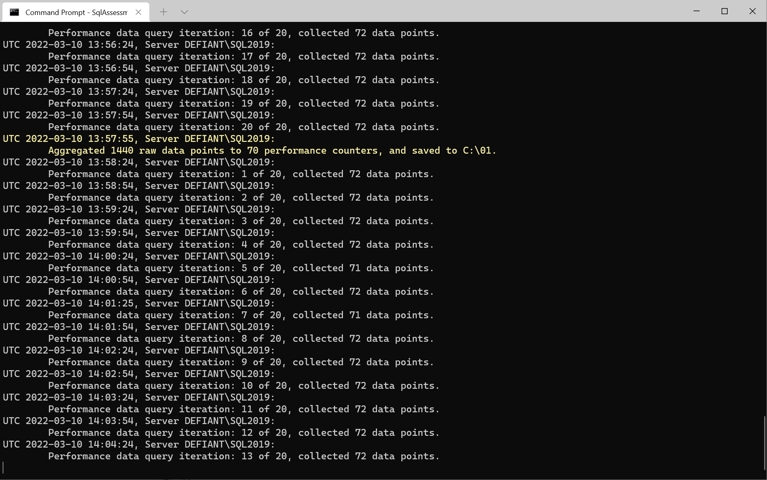
Run the tool
.\SqlAssessment.exe PerfDataCollection --sqlConnectionStrings "Data Source=DEFIANT\SQL2019;Initial Catalog=master;User ID=sa;Password=****" --outputFolder C:\Output

Slide 4
Get Recommendations
.\SqlAssessment.exe GetSkuRecommendation --outputFolder C:\01 --targetPlatform AzureSqlManagedInstance --elasticStrategy true

